Slide 1
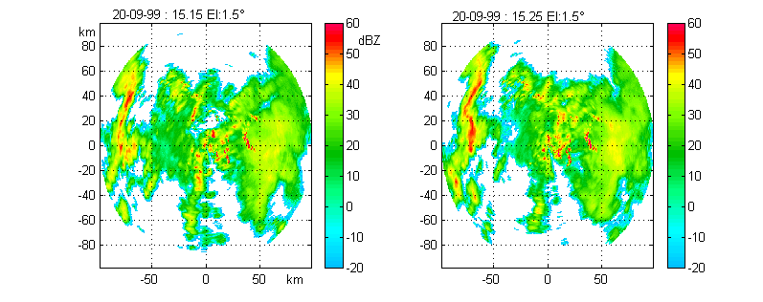
Rainfall Motion Estimation by Correlation - TREC
TREC - Tracking Radar Echoes by Correlation (Rinehart and Garvey, 1978)
L
Map at time t
Map at time t+ΔT
TREC relies on the crosscorrelation principle. Maps separated by a time lag T are ‘scanned’ by “boxes” with side L (fixed), internal grid resolution ΔG (fixed), and separated by Δb (fixed). The local motion vector of small-scale rainfall patterns is estimated as the space shift between the two boxes that exhibit the maximum correlation coefficient.
The matching of each box belonging to the image at time t is carried out over a search area of the image at time t+ΔT centered in the position of the original box and assuming a maximum displacement equal to R_{max}=u_{max}*ΔT, where u_{max} is the maximum admissible storm velocity.

Slide 2
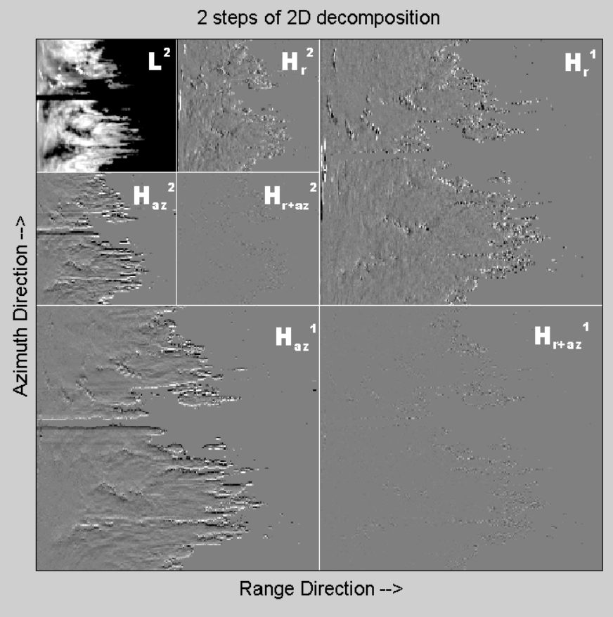
2-D wavelet decomposition
for multiresolution analysis
In the figure, a typical display of 2 steps dyadic decomposition is shown. The decomposition of 2-D signals, such as images, is usually obtained by using separable wavelets. This is simply obtained by processing the rows of the image by 1D wavelet analysis and then cascading processing along the columns. As a consequence, the spectrum is divided into four regions: the low-pass region corresponds to the approximation coefficients; the set of three detail signals represents three different high-frequency regions, where horizontal (range), vertical (azimuth) and diagonal (range-azimuth) high-frequency components are highlighted. The joint analysis of the four subbands allows, for instance, to point out possible anisotropy in the image.
The choice of the particular wavelet decomposition suitable for a specific application depends on the desired time-frequency localization properties. In the choice of the length of the wavelet support, frequency localization must be traded for space localization. In our application to weather radar data, Haar wavelet has been used since Haar filters have the minimum possible length, which assures that:
high computational speed is achieved
maximum spatial localization is achieved
the piecewise constant shape of Haar wavelet suitably matches the sharp edges typical of rainfields
the approximation coefficients at a given resolution are the values of the measured radar parameters averaged on an area the dimension of which depends on the resolution itself. Hence, the typical techniques of multiparametric classification can be directly applied to them.
Example of hierarchical dyadic wavelet decomposition applied to a reflectivity (Z_{H}) radar map

Slide 3
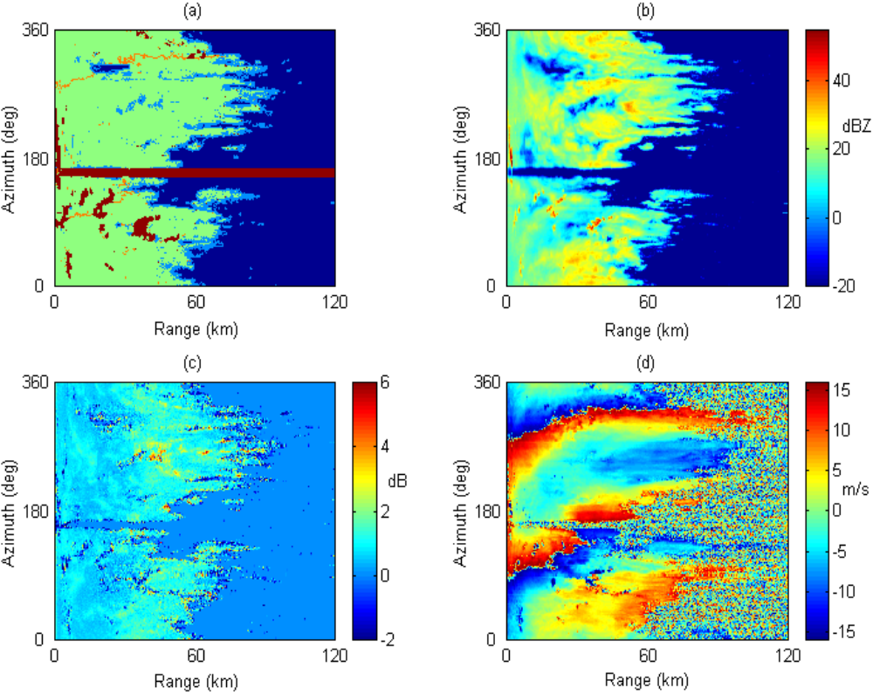
Multiresolution analysis: multiparameter
classification of radar echoes
An example of Thematic Map (TM)
Green: ‘Rain’
Blue: ‘No echo’
Red: ‘Unreliable’
Light blue: ‘Edge’
Orange: ‘Doppler jump’
Z_{H}
Z_{DR}
v

Slide 4
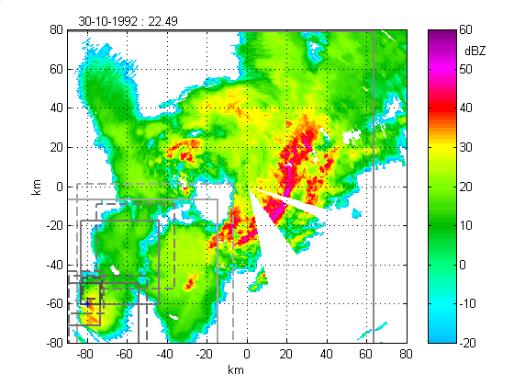
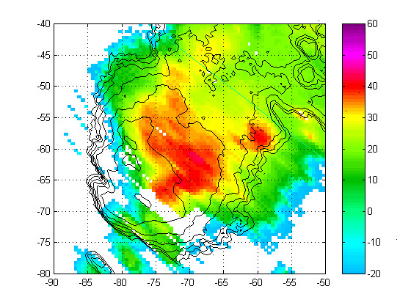
Multiscale box subdivision - example
22.59 ΔT=10 min

Slide 5
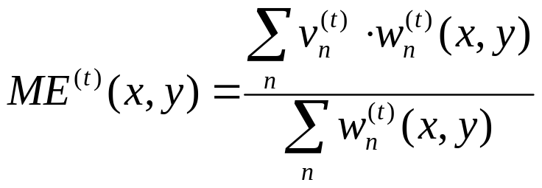
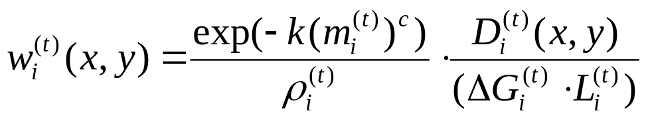
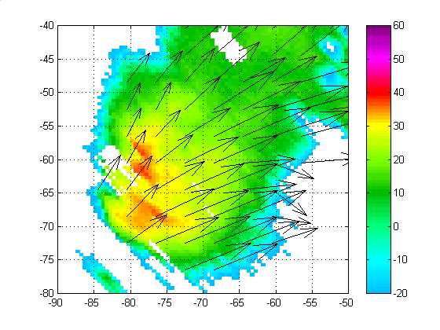
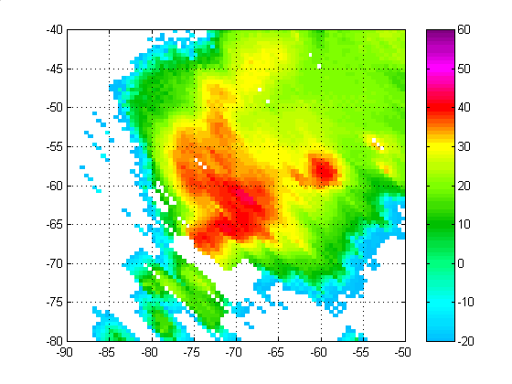
Velocity field estimation - example
Once the map has been segmented into several, possibly overlapping, boxes with different resolutions and sizes, their associated motion vector is merged in a single motion vector field with uniform spacing between vectors. The boxes having a reliable estimate of v_{i}^{(t)} are used. If the current grid point belongs to a single box, the motion vector is that associated to that box. If it belongs to more than one box, the motion vector is obtained as a weighted average of the associated motion vectors.
diameter of the largest circle centered on that grid point and inscribed in B_{i}^{(t}

Slide 6
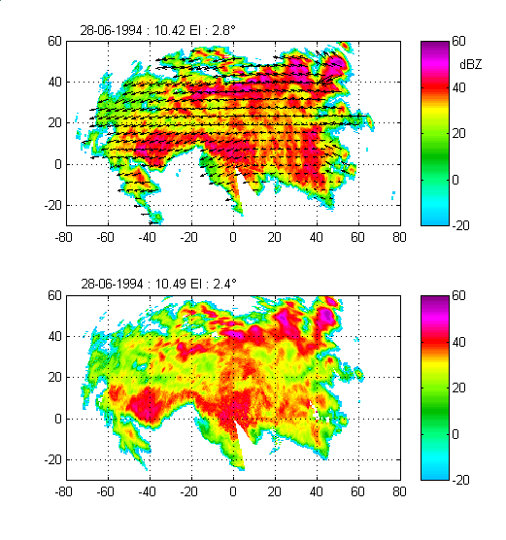
Estimated
velocity
field

Slide 7
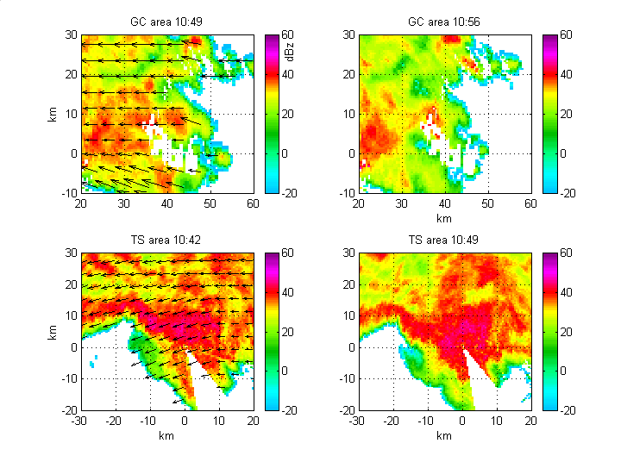
Details of ground clutter (GC) and totally shielded (TS) areas

Slide 8
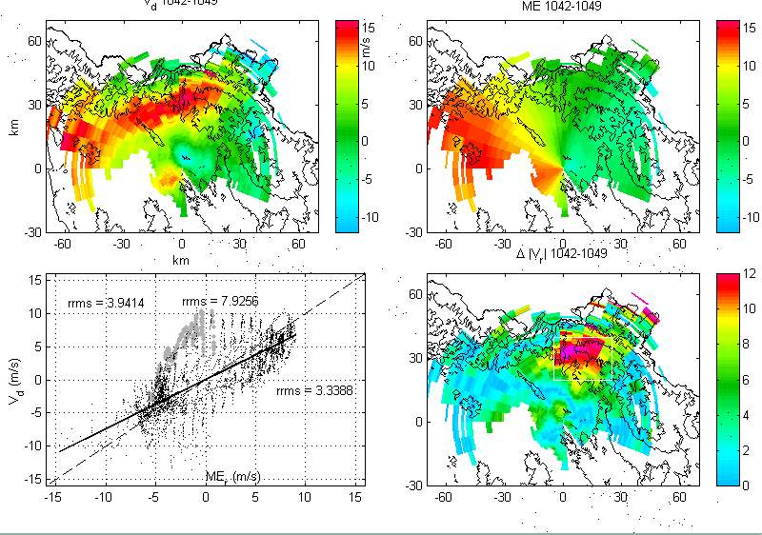
Comparison with mean Doppler radial velocity
Mountain area

